Slide 1
Tutorial Amortized and Expected Case Analysis
Chris Jefferson and Meinolf Sellmann

Slide 2
Outline
Amortized Complexity
Motivation
Amortized Filtering for Knapsack
Amortized Filtering for Context-Free Grammars
Amortized Filtering for Lex-Ordering
Expected-Case Analysis
Watched Literals in SAT
Filtering AllDifferent
Knapsacks in Sublinear Time

Slide 3
Classical Analysis of Filtering Algorithms
Filtering Efficiency
Given a constraint and current variable domains
How long does it take at most to compute all inconsistent domain values?
Example AllDifferent (see excellent survey from van Hoeve 2005)
Binary CSP Representation, Arc-Consistency O(n²)
AllDifferent, Range Consistency O(n²)
But do they really cost the same?

Slide 4
AllDifferent
BCSP Arc-Consistency O(n²)
For all i≠k, d_{k} in D(x_{k}) there exists d_{i} in D(x_{i}) s.t. C(d_{k},d_{i}) [i.e. d_{k} ≠ d_{i}]
When a domain becomes a singleton, remove this single value from all other domains.
Range-Consistency O(n²)
For all d_{k} in D(x_{k}) there exist d_{i} in [min(D(x_{i})), max(D(x_{i}))], for all i≠k, s.t. C(x₁,…,x_{n})
Hall Set K ⊆ {x₁,..,x_{n}} if |K| = |[min D_{K},max D_{K}]|
Traverse variables in the order of descending max D_{i}, inner loop traverse vars acc. to ascending min D_{k}

Slide 5
AllDifferent
Now consider the total work necessary down a branch of the search-tree with s nodes and t calls to the AllDifferent filtering algorithm.

Slide 6
AllDifferent
BCSP Arc-Consistency
Worst-case one-time invocation: O(n²)
Worst-case total effort per branch for t invocations: O(n²)
Range-Consistency
Worst-case one-time invocation: O(n²)
Worst-case total effort per branch for t invocations: O(tn²)

Slide 7


Amortized Analysis
Consider the total effort for an entire sequence of operations rather than one alone.
Example: Stack
Actual Costs:
Push: 1
Pop: 1
Multi-Pop of t elements: t
Cost of t stack operations: Σ_{i=1..t} i = O(t²)
Amortized Costs:
Push: 2
Pop: 0
Multi-Pop: 0
Cost of t stack operations: Σ_{i=1..t} 2 = O(t)
Saving for future pop operations!

Slide 8
Conclusions
Amortized Analysis
Consider a sequence of operations rather than only one! Accounting method: Save for later!

Slide 9
Outline
Amortized Complexity
Motivation
Amortized Filtering for Knapsack
Amortized Filtering for Context-Free Grammars
Amortized Filtering for Lex-Ordering
Expected-Case Analysis
Watched Literals in SAT
Filtering AllDifferent
Knapsacks in Sublinear Time

Slide 10

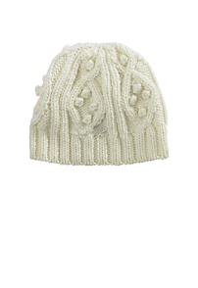
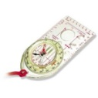

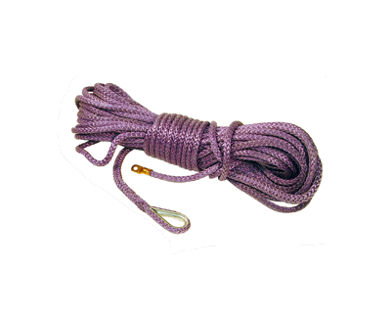
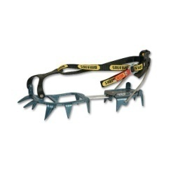



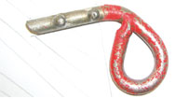
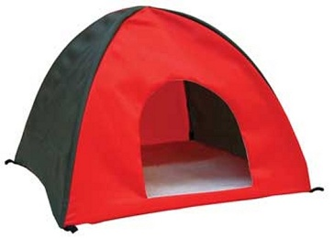
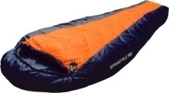
Knapsack Constraints
?
Items 1,.., n with
profits p₁,…, p_{n} and
weights w₁,..., w_{n}
Limited Capacity C
w^{T}x ≤ C
x ∈ {0,1}^{n}
p^{T}x → max!

Slide 11
Knapsack Constraints
Binary Variable Representation
x_{i} ∈ {0,1}
p^{T}x ≥ B and w^{T}x ≤ C
Is the constraint satisfiable?
Is a certain item taken in all feasible solutions?
Is a certain item never taken in any feasible solution?

Slide 12
Relaxed Consistency for Knapsacks
Achieving GAC (binary representation) is NP-hard
Rather than doing exact inference, we revert to inference based on an upper bound [Fahle/Sellmann AOR 2002]:
UB[x=b] < B → b ∉ D(x)

Slide 13
The Linear Relaxation Bound
Critical Item
Capacity
Weight
Efficiency

Slide 14
Relaxed Consistency
Critical Item
Capacity
Weight
Efficiency

Slide 15
Relaxed Consistency
Critical Item
Capacity
Weight
Efficiency

Slide 16
Relaxed Consistency
Critical Item
Weight
Efficiency

Slide 17
Linear Time Filtering
We need to sort the items by efficiency and weight: O(n log n) [amortized O(1)]
Computing the upper bound:
$1 for each critical item
$1 for each item that is fully included
The cost for an individual upper bound computation is: O(n)
The cost for all upper bound computations for all included items is: O(n) [amortized O(2n)]
Gold Standard: For at least Ω(log n) calls to the filtering routine, the cost per invocation is O(n)!

Slide 18
Conclusions
Amortized Analysis
Consider a sequence of operations rather than only one! Accounting method: Save for later!
Gold Standard: Amortization over a number of search nodes

Slide 19
Outline
Amortized Complexity
Motivation
Amortized Filtering for Knapsack
Amortized Filtering for Context-Free Grammars
Amortized Filtering for Lex-Ordering
Expected-Case Analysis
Watched Literals in SAT
Filtering AllDifferent
Knapsacks in Sublinear Time

Slide 20
Context-Free Grammars
A Context-free grammar is a 4-tuple (Σ,N,S₀,δ):
Σ – alphabet set
N – set of non-terminals
S₀ ∈ N – start symbol
δ : N → (N ∪ Σ)* – non-deterministic transition “function”

Slide 21
Context-Free Grammars
Example: ({‘(‘,’)’}, {S₀,A,B,C},S₀, δ) with transition function δ:
S₀ → AC, S₀ → BC, S₀ → S₀S₀
B → AS₀
A → ‘(‘, C → ‘)’

Slide 22
Context-Free Grammars
S₀
3
1. S₀ → AC
2. S₀ → BC
3. S₀ → S₀S₀
4. B → AS₀
5. A → ‘(‘
6. C → ‘)’
S₀
S₀
2
1
B
C
A
C
4
A
S₀
1
A
C
( ( ) ) ( )

Slide 23
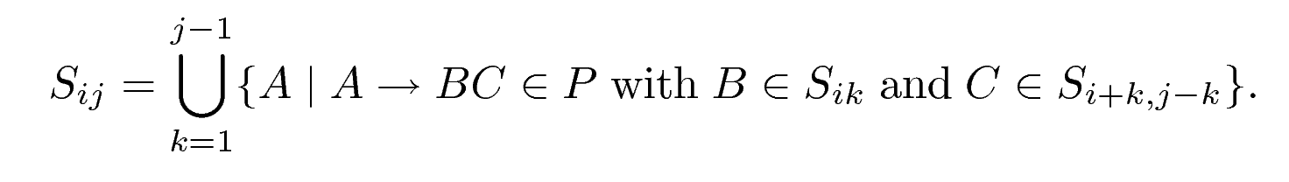
Context-Free Grammars
Parsing based on Dynamic Programmin [CYK]:
S_{ij} is the set of all non-terminals that can produce the word w_{i}..w_{i+j-1}
w ∈ L_{G} iff S₀ ∈ S_{1n}
Time needed: O(n³)

Slide 24
Context-Free Grammars
j
S₀ → AC
S₀ → BC
S₀ → S₀S₀
B → AS₀
A → ‘(‘
C → ‘)’
4
3
2
1
w | ( | ( | ) | )
 | 1 | 2 | 3 | 4
i

Slide 25
Context-Free Grammars
j
S₀ → AC
S₀ → BC
S₀ → S₀S₀
B → AS₀
A → ‘(‘
C → ‘)’
4
3
2
1 | A | A | C | C
w | ( | ( | ) | )
 | 1 | 2 | 3 | 4
i

Slide 26
Context-Free Grammars
j
S₀ → AC
S₀ → BC
S₀ → S₀S₀
B → AS₀
A → ‘(‘
C → ‘)’
4
3
2 |  | S₀
1 | A | A | C | C
w | ( | ( | ) | )
 | 1 | 2 | 3 | 4
i

Slide 27
Context-Free Grammars
j
S₀ → AC
S₀ → BC
S₀ → S₀S₀
B → AS₀
A → ‘(‘
C → ‘)’
4
3 | B
2 |  | S₀
1 | A | A | C | C
w | ( | ( | ) | )
 | 1 | 2 | 3 | 4
i

Slide 28
Context-Free Grammars
j
S₀ → AC
S₀ → BC
S₀ → S₀S₀
B → AS₀
A → ‘(‘
C → ‘)’
4 | S₀
3 | B
2 |  | S₀
1 | A | A | C | C
w | ( | ( | ) | )
 | 1 | 2 | 3 | 4
i

Slide 29
From Parsing to Pruning

Slide 30
From Pruning to Filtering

Slide 31
From Pruning to Filtering

Slide 32
CFG Constraint Filtering
Theorem [Sellmann CP’06]:
Generalized Arc-Consistency for Context-Free Grammar Constraints can be achieved in time O(n³ |δ|).

Slide 33
Incremental Constraint Filtering
Propagation algorithm is called many times on slightly changing problems
General idea: Reuse parts of old computation!
Here: Reuse the parse graph!
Alternatively: Decompose the constraint [Quimper/Walsh CP 2007]
Problem: Space requirements are cubic!

Slide 34
Incremental Constraint Filtering

Slide 35
Incremental Constraint Filtering
Order supports from above and below!
Save only one support (from above and from below) for each node.
When lost, start looking for replacement after the lost support (wrt support ordering). [Bessiere/Cordier AAAI 1993]

Slide 36
CFG Constraint Filtering
Theorem [Sellmann CP’06]:
Generalized Arc-Consistency for Context-Free Grammar Constraints can be achieved in time O(n³ |δ|).
Theorem [Kadioglu/Sellmann AAAI’08]:
Generalized Arc-Consistency for Context-Free Grammar Constraints for an entire sequence of monotonically tightening filtering problems can be achieved in time O(n³ |δ|) and space O(n² |δ|).

Slide 37
Backtracking

Slide 38
Experimental Results
Shift-Scheduling Problem
A shift covers 3-8 hours of work.
Each activity lasts at least one hour.
A break/lunch is required when switching activities.
Breaks, lunches, and off-shifts are non-consecutive
Off-shifts are required at the beginning and end of each shift
If at least 6 hours of work, two 15-minute breaks and lunch are required.
If less than 6 hours work, there is exactly one 15-minute break (and no lunch).
Upper and lower bounds on the number of workers in each 15-minute time interval.

Slide 39
Experimental Results
[Quimper/Rousseau Metaheuristics 2007]:
R → rR | r L → lL | l A_{i} → a_{i} A_{i} | a_{i}
W → A_{i} P → WbW F → PLP
S → RPR | RFR

Slide 40
Experimental Results

Slide 41
Amortization
Why do we amortize over one branch of the tree rather than the entire tree?
Because in the worst-case all the costs may incur on the last level only!
Gold Standard: Amortize over a certain number of search nodes (no matter where they occur).
Silver Standard: Amortize over one branch on the tree [Note that this may be the best we can do!]

Slide 42
Conclusions
Amortized Analysis
Consider a sequence of operations rather than only one! Accounting method: Save for later!
Gold Standard: Amortization over a number of search nodes
Silver Standard: Amortization over one branch of the search tree

Slide 43
Outline
Amortized Complexity
Motivation
Amortized Filtering for Knapsack
Amortized Filtering for Context-Free Grammars
Amortized Filtering for Lex-Ordering
Expected-Case Analysis
Watched Literals in SAT
Filtering AllDifferent
Knapsacks in Sublinear Time

Slide 44
Lex Ordering
Lexicographic (dictionary) ordering of two vectors of variables.
[x₁, x₂, ... , x_{n}] ≤_{lex} [y₁, y₂, ... , y_{n}]
x₁ ≤ y₁
For all i<n, if [x₁ , ... , x_{i}] = [y₁, … , y_{i}] then x_{i+1} ≤ y_{i+1}

Slide 45
Lex Ordering
Used in a number of problems.
Particularly important in symmetry breaking.
For complete symmetry breaking, can be necessary to add 10,000s, or even 100,000s of lex constraints.

Slide 46
A Tale of Two Pointers
We use two pointers, α and β, to avoid repeatedly traversing the vectors.
We index the vectors as follows:
 | 0 | 1 | 2 | 3 | 4
x | {2} | {1,3,4} | {1,2,3,4,5} | {1,2} | {3,4,5}
y | {0,1,2} | {1} | {0,1,2,3,4} | {0,1} | {0,1,2}

Slide 47
A Tale of Two Pointers
We use two pointers, α and β, to avoid repeatedly traversing the vectors.
 | 0 | 1 | 2 | 3 | 4
x | {2} | {1,3,4} | {1,2,3,4,5} | {1,2} | {3,4,5}
y | {0,1,2} | {1} | {0,1,2,3,4} | {0,1} | {0,1,2}
α: index such that all variables at more significant indices are ground and equal.

Slide 48
A Tale of Two Pointers
We use two pointers, α and β, to avoid repeatedly traversing the vectors.
 | 0 | 1 | 2 | 3 | 4
x | {2} | {1,3,4} | {1,2,3,4,5} | {1,2} | {3,4,5}
y | {0,1,2} | {1} | {0,1,2,3,4} | {0,1} | {0,1,2}
α: index such that all variables at more significant indices are ground and equal.
β: most significant index from which the two vectors’ tails necessarily violate the constraint.

Slide 49
A Tale of Two Pointers
We use two pointers, α and β, to avoid repeatedly traversing the vectors.
 | 0 | 1 | 2 | 3 | 4
x | {2} | {1,3,4} | {1,2,3,4,5} | {1,2} | {3,4,5}
y | {0,1,2} | {1} | {0,1,2,3,4} | {0,1} | {0,1,2}
α: index such that all variables at more significant indices are ground and equal.
β: If tails never violate the constraint: ∞

Slide 50
Pointer Initialisation
Needs one traversal of the vectors (linear).
 | 0 | 1 | 2 | 3 | 4
x | {2} | {1,3,4} | {1,2,3,4,5} | {1,2} | {3,4,5}
y | {0,1,2} | {1} | {0,1,2,3,4} | {0,1} | {0,1,2}
α
α : index such that all variables at more significant indices are ground and equal.
β : most significant index from which the two vectors’ tails necessarily violate the constraint.

Slide 51
Pointer Initialisation
Needs one traversal of the vectors (linear).
 | 0 | 1 | 2 | 3 | 4
x | {2} | {1,3,4} | {1,2,3,4,5} | {1,2} | {3,4,5}
y | {0,1,2} | {1} | {0,1,2,3,4} | {0,1} | {0,1,2}
α
β
α: index such that all variables at more significant indices are ground and equal.
β: most significant index from which the two vectors’ tails necessarily violate the constraint.

Slide 52
Lex pruning
Algorithm falls into two parts:
Must always be true that X[α] ≤ Y[α]
If X[α] and Y[α] are assigned and equal, increment α.
If variable between index α and β changes, might have to update β.
If α = β+1, then propagate X[α] < Y[α].

Slide 53
Updating β
Some index i between α and β has changed. There are two cases:
It is now required that X[i] > Y[i].
Then β =i.
It is now required that X[i] ≥ Y[i].
Then only if β = i+1, move β to i, and keep going down for as long as X[β-1] ≥ Y[β-1] is true.

Slide 54
Lex Complexity
Clearly an O(n) cost on first node
Have to find initial positions of α and β!
O(n) worst case cost
Might have to move β all the way back along the array.
Consider the cost down entire branch of branch.

Slide 55
Amortised Complexity
Down any one branch of search, most calls to the algorithm cost O(1) per literal removal.
The only part which is not O(1) is moving β backwards when X[i] ≥ Y[i], and β = i+1.
This can only happen at most n times down a branch!
So the cost down one branch is O(n+c), where n is the number of variables and c is the number of times the constraint is called.

Slide 56
Outline
Amortized Complexity
Motivation
Amortized Filtering for Knapsack
Amortized Filtering for Context-Free Grammars
Amortized Filtering for Lex-Ordering
Expected-Case Analysis
Watched Literals in SAT
Filtering AllDifferent
Knapsacks in Sublinear Time

Slide 57
Expected-Case Analysis
Filtering problems, as they occur as part of a propagation engine, should not be viewed as adversarial.
Arguably, if it takes too long, a filtering attempt can even be aborted.
What matters is the common case and not the rare exception.
How can we analyze and improve the runtime of filtering algorithms?

Slide 58
What is Expected?
How can we find how well our algorithm performs “on average”?
Assume every possible search state is equally likely, and take the average performance over all of them.
This is not particularly realistic
There are ways we can make it more realistic.
With care, it average case analysis provides a useful tool to understand how propagators perform.

Slide 59
What is a Search Space?
Easy: Assume every literal appears in exactly half of the possible search spaces.
So every literal has a probability of a half of appearing, independently.
Problem: This allows states where some variables have no allowed domain values.
If we fix this problem, then the probability of a literal in a variable of domain size d appearing is d/(d+1).

Slide 60
Maximum Cliques
1
1
8
6
2
2
2
3
3
3
7
4
4
1
4
5
5
5
6
6
7
7
8
8

Slide 61
Maximum Cliques
1
1
8
6
2
2
2
3
3
3
7
4
4
1
4
5
5
5
6
6
Regin CP’04:
Clique(G) ≤ |V| - ⎡Matching(G^{B})/2 ⎤
Pre-Test:
|V| - ⎡|V|/2⎤ ≥ Best
7
7
8
8

Slide 62
Conclusions
Amortized Analysis
Consider a sequence of operations rather than only one! Accounting method: Save for later!
Gold Standard: Amortization over a number of search nodes
Silver Standard: Amortization over one branch of the search tree
Expected Case Analysis
Use pre-conditions to avoid unnecessary work!

Slide 63
Outline
Amortized Complexity
Motivation
Amortized Filtering for Knapsack
Amortized Filtering for Context-Free Grammars
Amortized Filtering for Lex-Ordering
Expected-Case Analysis
Watched Literals in SAT
Filtering AllDifferent
Knapsacks in Sublinear Time

Slide 64
2 Watched Literal SAT
Constraints of the form: a ∨ b ∨ c ∨ d
Algorithm is also known as DPLL
The central algorithm of most current SAT solvers.
Performs very efficiently in practice, despite poor worst-case complexity.
Bad amortised complexity too!

Slide 65
Simple Propagator
Start with a counter equal to number of variables.
Decrement by 1 with every variable assigned false.
When it reaches 1, assign the remaining variable true.
With a bit of cleverness, can make this assignment O(1), not an O(n) search.
So algorithm is O(1) per literal removal. How can we beat that?

Slide 66
Watched Literals
Algorithm watches some subset of the literals in the constraint.
We assume literals which are not watched cause ZERO work when removed.
Constraint can change the literals it watches.
They do not revert on backtrack.
In general this does not improve worst-case complexity, but will improve the average case.

Slide 67
Propagation Example
0/1 | 0/1 | 0/1 | 0/1
a | b | c | d
Triggers:
a ∨ b ∨ c ∨ d

Slide 68
Propagation Example
0 | 0/1 | 0/1 | 0/1
a | b | c | d
Triggers:
a assigned false.
Update pointer.

Slide 69
Propagation Example
0 | 0/1 | 0/1 | 0/1
a | b | c | d
Triggers:
a assigned false.
Update pointer.

Slide 70
Propagation Example
0/1 | 0/1 | 0/1 | 0/1
a | b | c | d
Triggers:
Backtrack. a unassigned.
Pointers do not move back

Slide 71
Propagation Example
0/1 | 1 | 0/1 | 0/1
a | b | c | d
Triggers:
If b is assigned true, pointer doesn’t move.

Slide 72
Propagation Example
0 | 0/1 | 0/1 | 0
a | b | c | d
Triggers:
If other variables assigned, nothing happens!

Slide 73
Propagation Example
0 | 0 | 0/1 | 0
a | b | c | d
Triggers:
If we cannot find something new to watch...

Slide 74
Propagation Example
0 | 0 | 1 | 0
a | b | c | d
Triggers:
Assign other watch!

Slide 75
Propagation Example
0 | 0 | 1 | 0
a | b | c | d
Triggers:
Leave triggers where they are!

Slide 76
Propagation Example
0 | 0/1 | 0/1 | 0
a | b | c | d
Triggers:
Triggers in the right place to continue after backtracking.

Slide 77
Analysing SAT
Each invocation is O(n)
If triggers revert on backtrack, worst case is O(n) down a branch.
If triggers do not revert on backtrack, worst case is O(n²) down a branch.
Because we have to keep searching along the array, we can’t assume as we have got to the end we can backtrack.

Slide 78
Average Case Analysis
There is a chance of 1/n of a literal removal triggering the constraint
2 literals out of 2*n (2 per variable).
What happens when we need to find a new support?
We cannot assume that we only need to search to the end of the array, from our current position.

Slide 79
Probabilities
If probability of a event is p, what is the expected number of checks we must make?
First check: p
Second check: (1-p)p
Third check: (1-p)²p
n^{th} check: (1-p)^{(n-1)}p
Last (m^{th}) check: (1-p) ^{m}

Slide 80
Maths!
What is the average number of times we must perform an activity with probability p, until it succeeds?
Solve a complex infinite sum.
Use a cute trick.
It’s 1/p.

Slide 81
Average distance for SAT
We want to find the first variable where the appropriate domain value is still present (true or false).
Probability is 1/2, or 2/3 if we forbid empty domains.
Expected number of checks is 2, or 3/2.

Slide 82
SAT Analysis
SAT - 2 steps.
When a single literal is removed, on average we do:
2/2n – watching 2 literals out of 2n.
*2 – expected amount of work
=2/n average checks per removed literal.
=O(1/n) expected work per removed literal!

Slide 83
Achieving ‘Average’
In practice, search states are not evenly distributed.
Some things we cannot help – the number of literals in each variable.
Can remove any patterns in the distribution of variables by randomizing the order they are searched in.
Can randomize each search, or once at first.
Common problem – order of variables follow order of search, leads to degenerate behavior.

Slide 84
Other Constraints
There are a number of other constraints which follow this pattern of ‘scan along until something is found’.
Most Watched Literal constraints.
The conditions to check can be harder, but the analysis follows a similar pattern.
Element scans two lists of literals to find the first index where both are present.
Requires average case 4 steps.

Slide 85
Outline
Amortized Complexity
Motivation
Amortized Filtering for Knapsack
Amortized Filtering for Context-Free Grammars
Amortized Filtering for Lex-Ordering
Expected-Case Analysis
Watched Literals in SAT
Filtering AllDifferent
Knapsacks in Sublinear Time

Slide 86
All Different
The classic global constraint.
One of the most studied problems in CP.
Many implementations with different propagation / complexity tradeoffs.
We shall consider here the expected-case analysis of Irit Katriel.

Slide 87
Implementing AllDiff
Alldiff is an example of a flow propagator.
Build a network of nodes and edges, representing a series of tubes, where valid flows represent solutions to the constraint.
Map each variable and value to a node, connect varible x to value v if v is in domain of x.

Slide 88
Régin's Algorithm
s
Find maximum flow from s to t
All edges carry 0 or 1 units
Think of water flowing through pipes
A
B
C
D
1
2
3
4
5
6
t

Slide 89
Algorithm: Part 1
s
Find a single satisfying assignment
Hopcroft & Karp’s algorithm
O(e.√n)
A
B
C
D
1
2
3
4
5
6
t

Slide 90
Algorithm: Part 2
s
Propagate by finding the strongly connected components (SCCs)
Berge’s algorithm:
O(e + n)
A
B
C
D
1
2
3
4
5
6
t

Slide 91
Incremental Propagation
Hardest part of algorithm is finding a satisfying flow: O(e.√n)
If only one edge is lost in a satisfying flow, we can fix it in O(e + n).
Switch between algorithms depending on how many edges have been lost.
Can we do better?

Slide 92
Important Edges
Given the flow graph, we can find a set of important edges.
If no important edge is removed, no propagation can occur.
There are many sets of important edges.
Always exists a set of size at most 3n.

Slide 93
Expected Filtering
We know only 3n edges out of e are important.
Expect to lose an important edge every e/3n deletions.
If we only propagate every e/3n deletions, the expected amount of propagation is the same!

Slide 94
Incremental vs. Recalculating
Incremental: O(e+n)
Recalculate: O(e.√n)
What is the cost after O(e/n) edges have been deleted?
Incremental: O(e+n).O(e/n) = O(e²/n)
Recalcuate: O(e.√n)
If e = O(n√n), it is cheaper to recalculate.

Slide 95
Limitations
There are some limitations of expected filtering.
Possible to construct problems where nieve expected filtering leads to an exponentially larger search space.
Could ensure propagator is run at the end of each node.
Then difficult to know if on that node it will be worth up-front doing incremental or complete.

Slide 96
Alternative use of Important Edges
(Nightingale et. al): Instead of using a probabilistic argument, we can explicitly store a set of important edges, and only invoke the propagator in this case.
Argument follows identically, except now the algorithm behaves identically to the standard algorithm.
Useful in practice for large domains.

Slide 97
Conclusions
Amortized Analysis
Consider a sequence of operations rather than only one! Accounting method: Save for later!
Gold Standard: Amortization over a number of search nodes
Silver Standard: Amortization over one branch of the search tree
Expected Case Analysis
Use pre-conditions to avoid unnecessary work!
Fix a filtering instance distribution
Silver Standard:
Expectation applied to every search node independently

Slide 98
Outline
Amortized Complexity
Motivation
Amortized Filtering for Knapsack
Amortized Filtering for Context-Free Grammars
Amortized Filtering for Lex-Ordering
Expected-Case Analysis
Watched Literals in SAT
Filtering AllDifferent
Knapsacks in Sublinear Time

Slide 99
Knapsacks (Again)
Critical Item
Capacity
Weight
Efficiency

Slide 100
Filtering in Expected Sublinear Time
Observation
Let x_{i}, x_{j} ∈ {x₁, . . . , x_{s}} such that
p_{i}/w_{i} ≥ p_{j}/w_{j} and w_{i} ≥ w_{j}:
If x_{i} is not mandatory, then x_{j} is not mandatory.
Therefore
if we hit an item that is not mandatory
we can skip over all items in the efficiency ordering with lower weight!

Slide 101
Filtering in Expected Sublinear Time
We need an efficient data structure
to re-compute the critical item
to find the next item to check for filtering
while supporting fixing of items by other constraints
We use Finger Trees [Mehlhorn’80].

Slide 102
Finger Trees

Slide 103
Finger Trees

Slide 104
Finger Trees

Slide 105
Finger Trees

Slide 106
Finger Trees

Slide 107
Finger Trees

Slide 108
Finger Trees

Slide 109
Finger Trees

Slide 110
Finger Trees

Slide 111
Finger Trees

Slide 112
Filtering in Expected Sublinear Time
The time to find the next item is logarithmic in the number of items between the last and the new!
The total time to filter k items is therefore in O(k log(n/k)).
When efficiency and weight of items are drawn independently, the expected longest increasing weight subsequence is O(sqrt(n)). Thus, k ∈ O(sqrt(n))!
Then, the filtering time is reduced to expected O(sqrt(n) log(n)).
In the worst-case, filtering is still linear time.

Slide 113
Heuristic Improvements
Early Termination [SL-ET]
Do not determine the exact weight that we can afford to lose
Stop early when
the minimum weight we can afford to lose already exceeds the weight of the item.
the maximum weight we can afford to lose is already less than the weight of the item.
Strong Skipping [SL-SS]
Use the maximum weight that can be afforded to be lost as lower bound

Slide 114
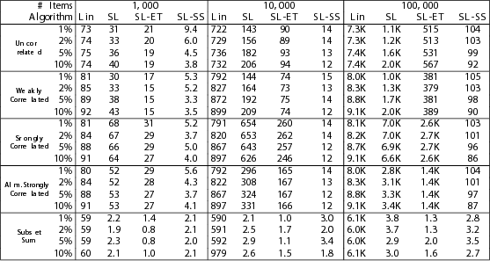
Numerical Results

Slide 115
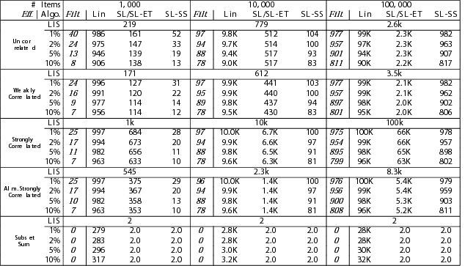
Numerical Results

Slide 116
Conclusions
Amortized Analysis
Consider a sequence of operations rather than only one! Accounting method: Save for later!
Gold Standard: Amortization over a number of search nodes
Silver Standard: Amortization over one branch of the search tree
Expected Case Analysis
Use pre-conditions to avoid unnecessary work!
Fix a filtering instance distribution
Silver Standard:
Expectation applied to every search node independently
Gold Standard:
Note that problems could change adversely after filtering and branching!
Expectation limited to input instance!

Slide 117
Thank You!

